Slide 1
HMS Vision of Learning
Inquiry Based
Learning
21st Century L & I:
Critical Thinking
Creativity
Communication
Collaboration
Strategy Integration
&
Formative Assessment
Interdisciplinary Concepts
Global Trends
&
Events

Slide 2






21st Century Paradigm
Collaboration
Communication
Critical Thinking
&
Creativity

Slide 3
HMS Highlights
Family Math Night
First Lego League
Google Chrome Paperless Classroom
Hispanic Heritage Program
Select Chorus Winter Concert Preview

Slide 4

Family Math Night

Slide 5
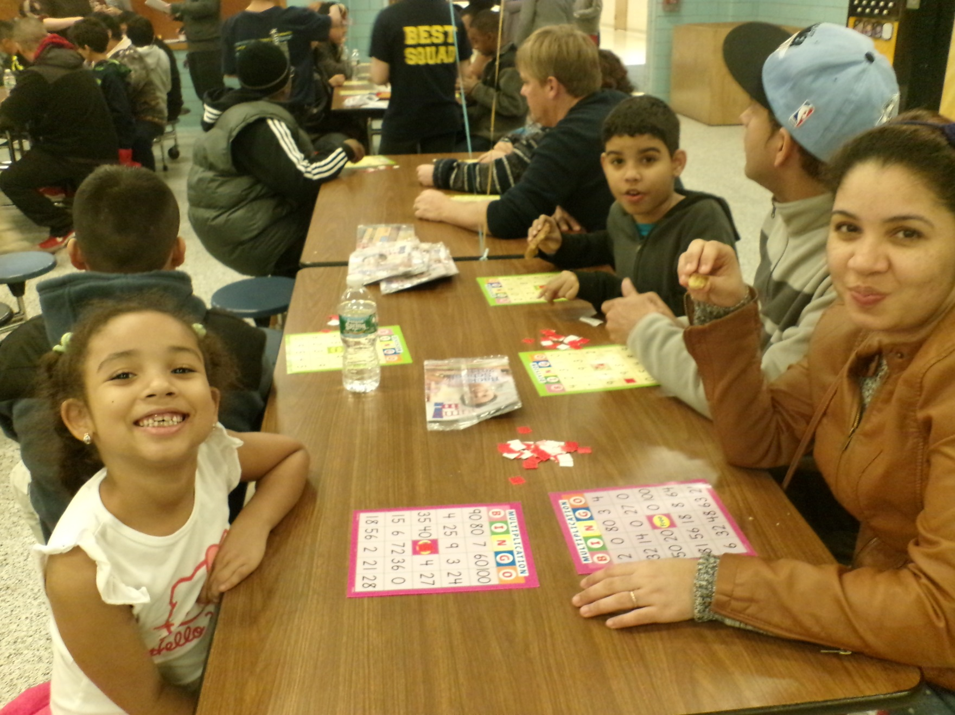

Slide 6

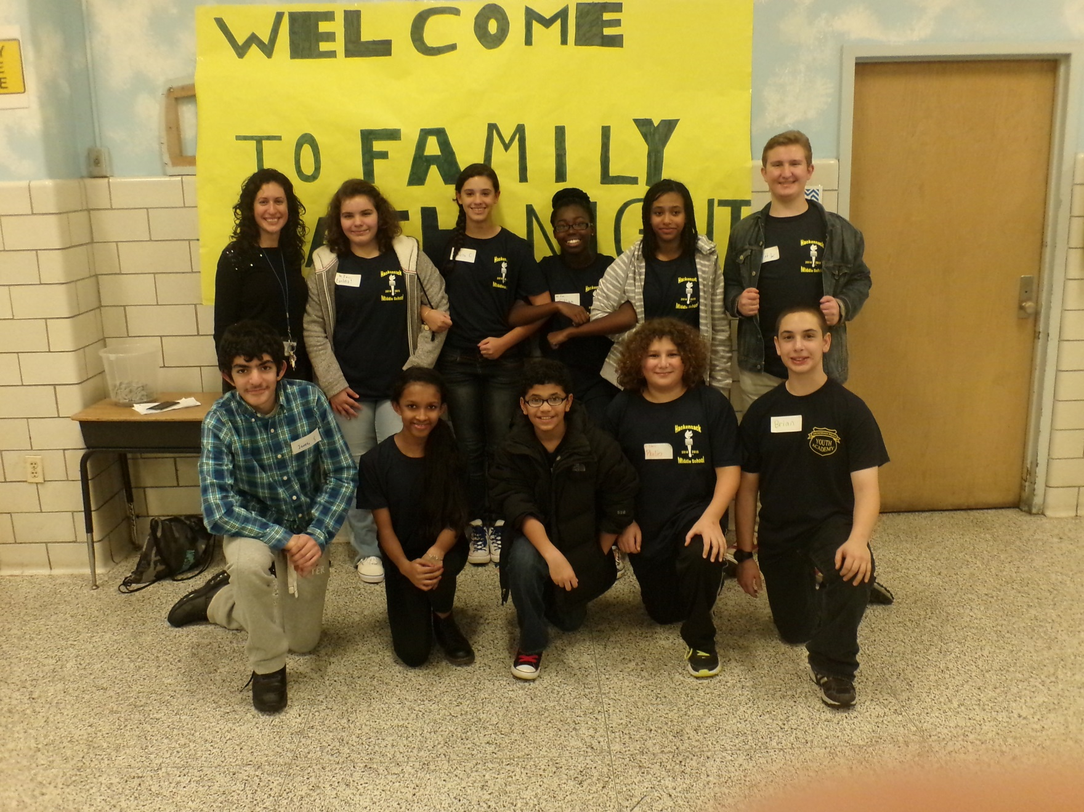

Slide 7
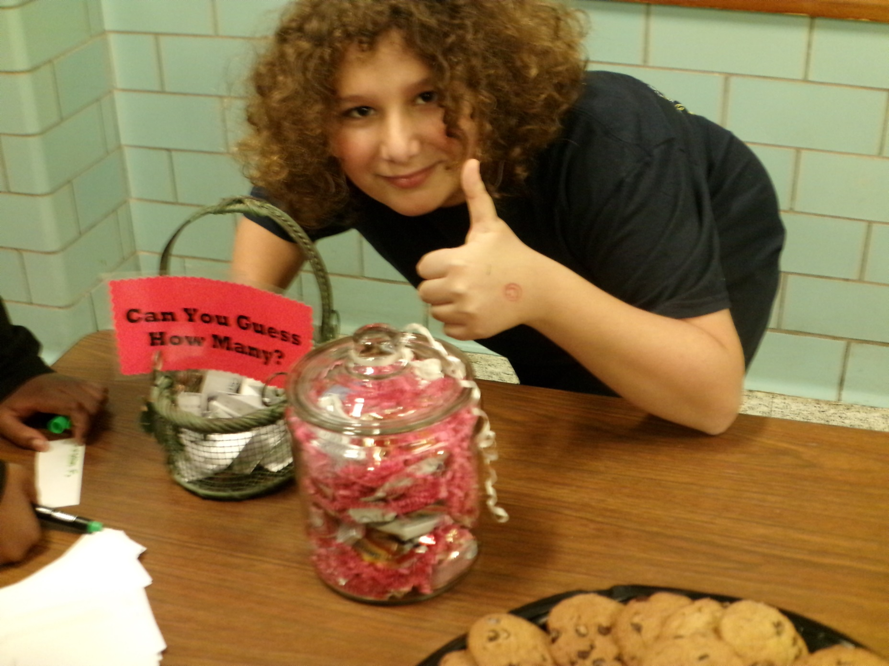

Slide 8

First Lego League Competition

Slide 9
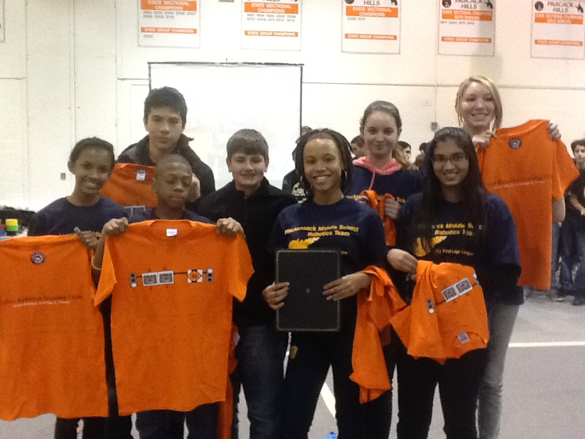

Slide 10
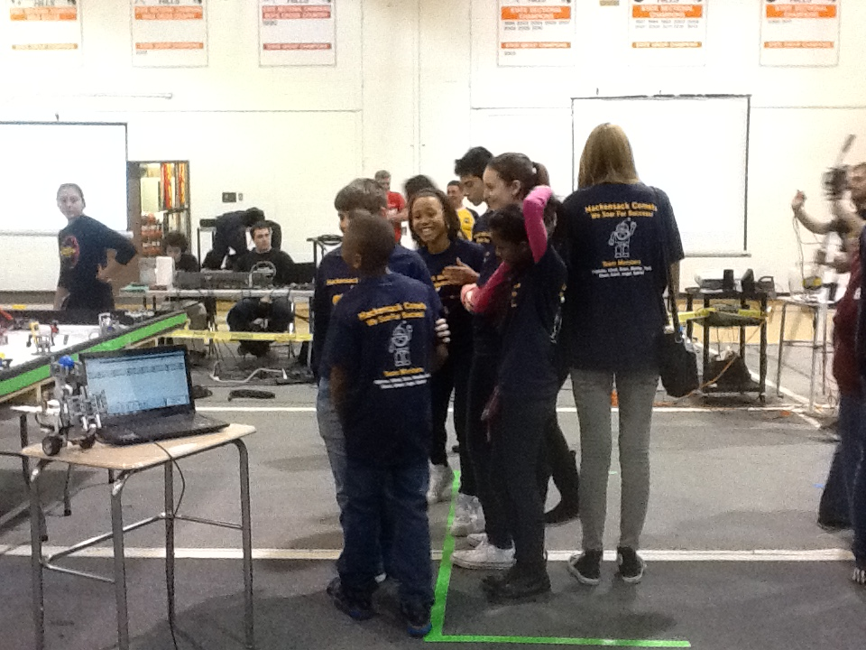

Slide 11

Google Chrome Paperless Classroom

Slide 12
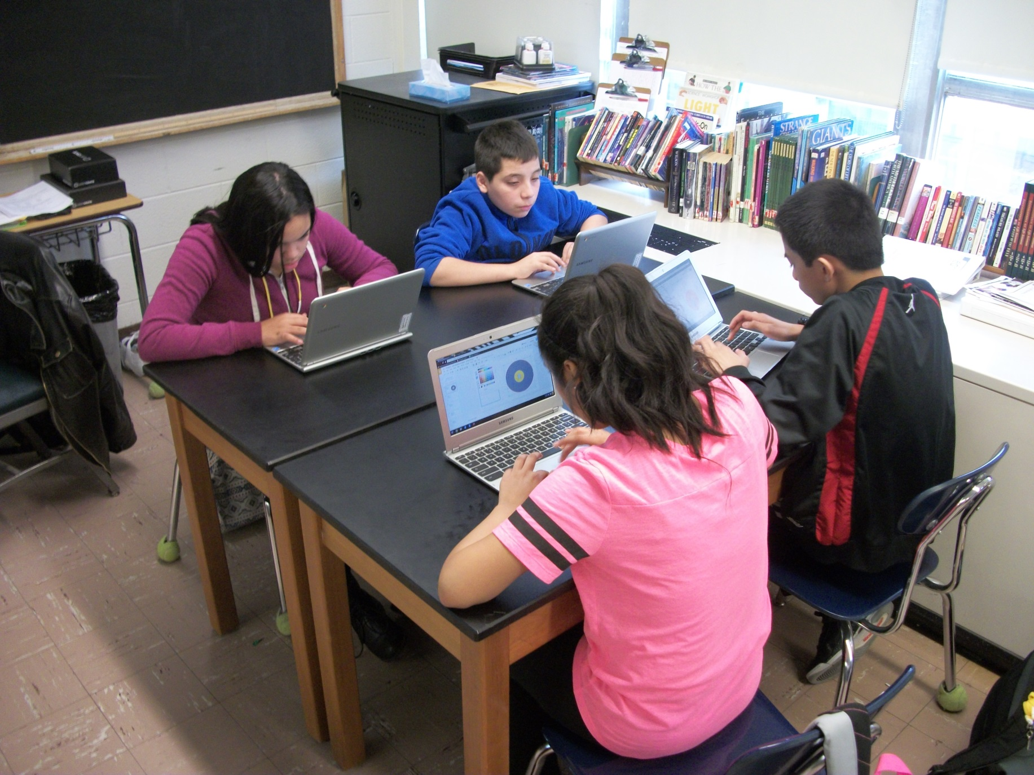

Slide 13
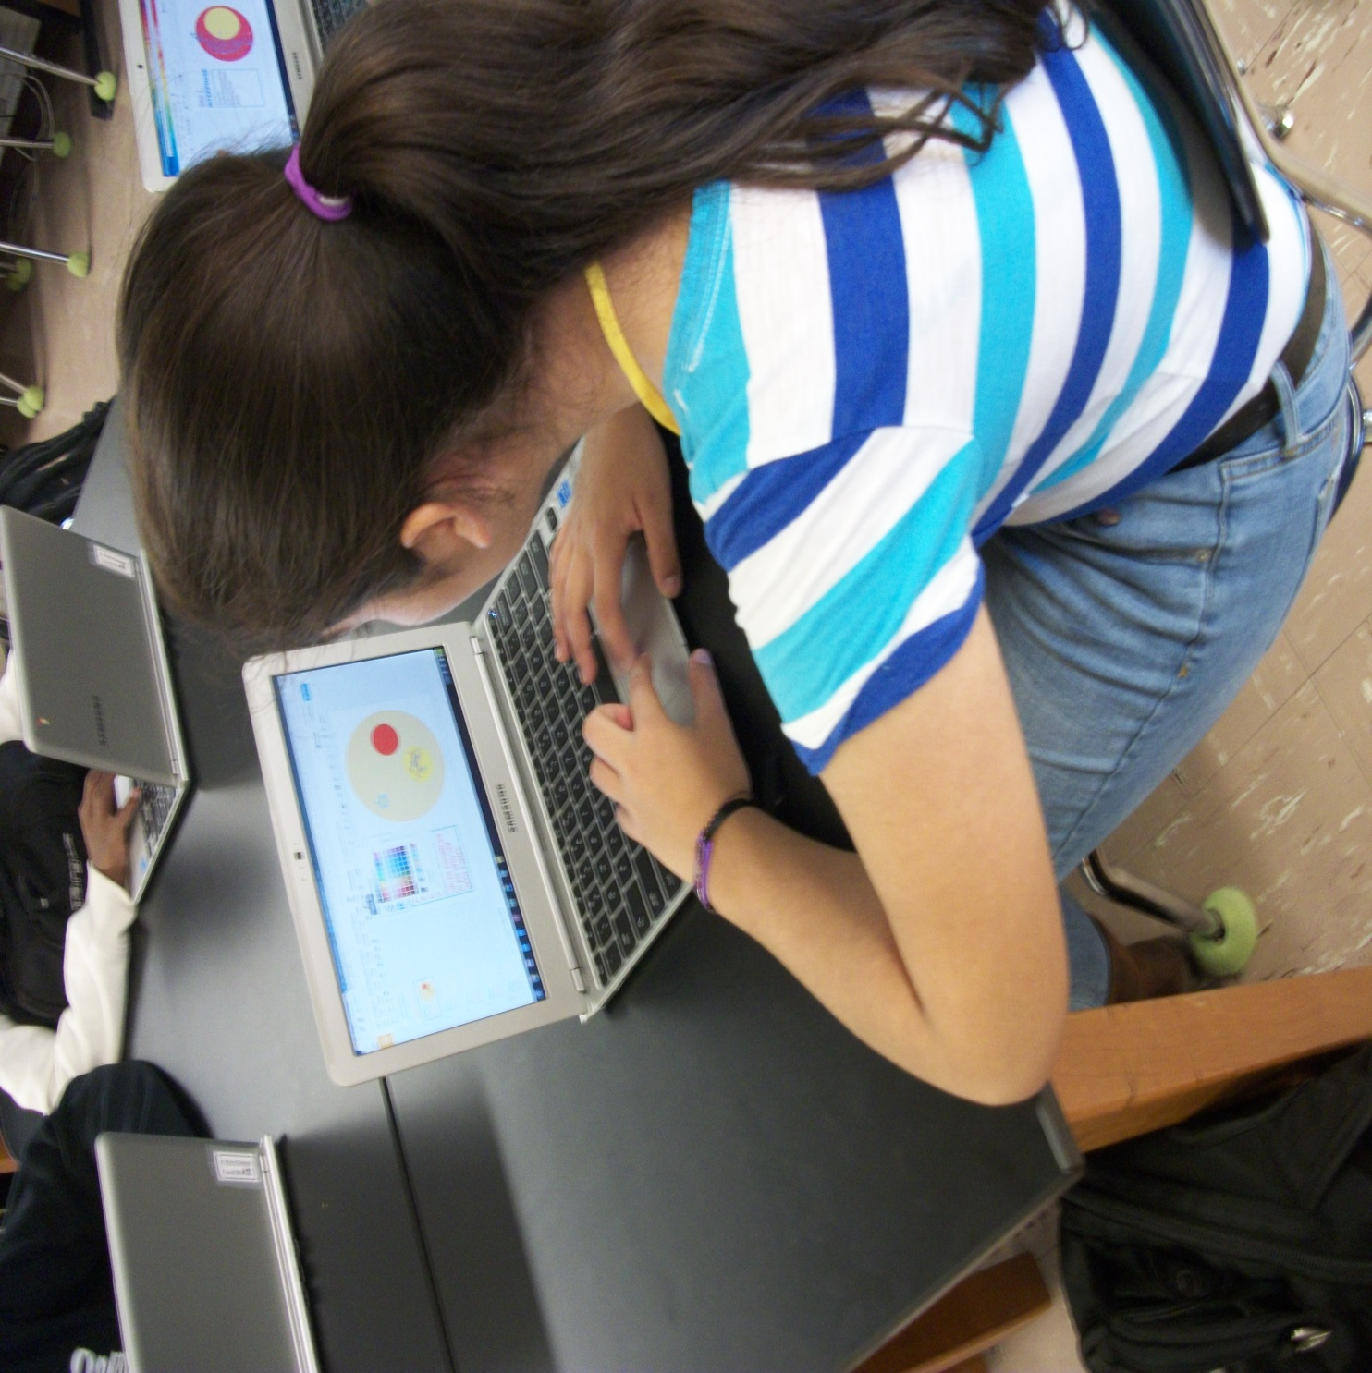

Slide 14

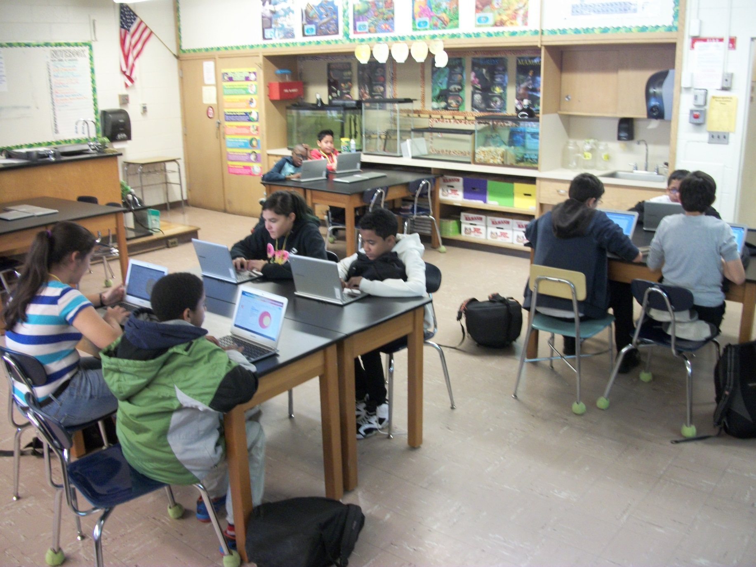

Slide 15

Hispanic Heritage Program

Slide 16
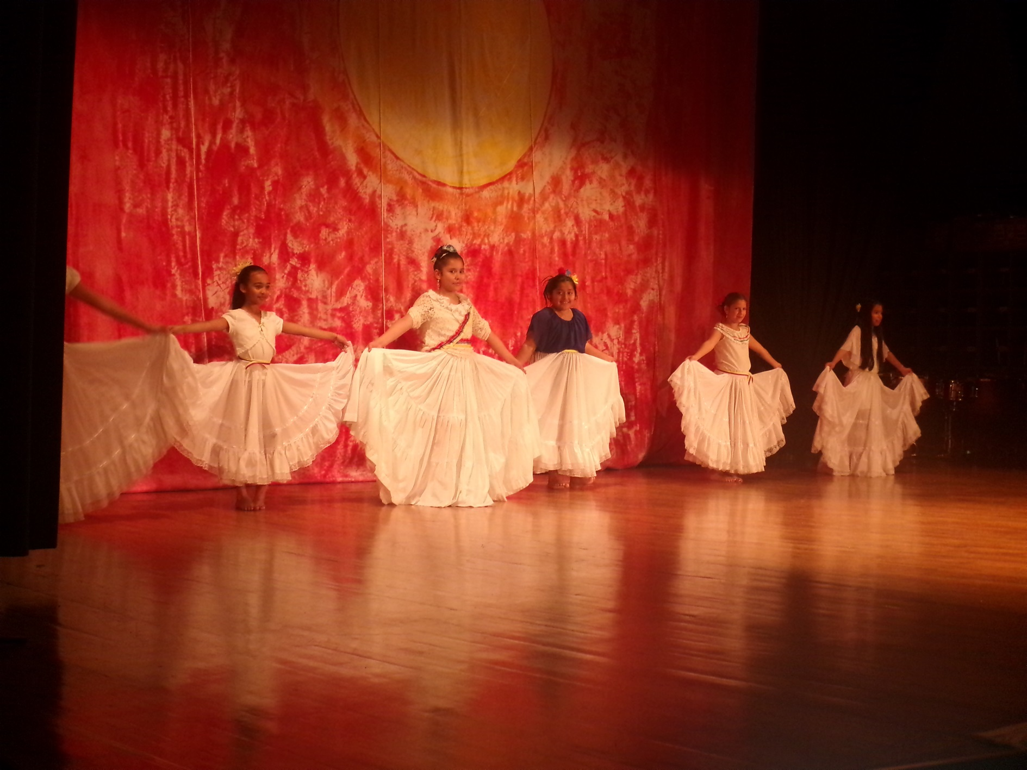

Slide 17
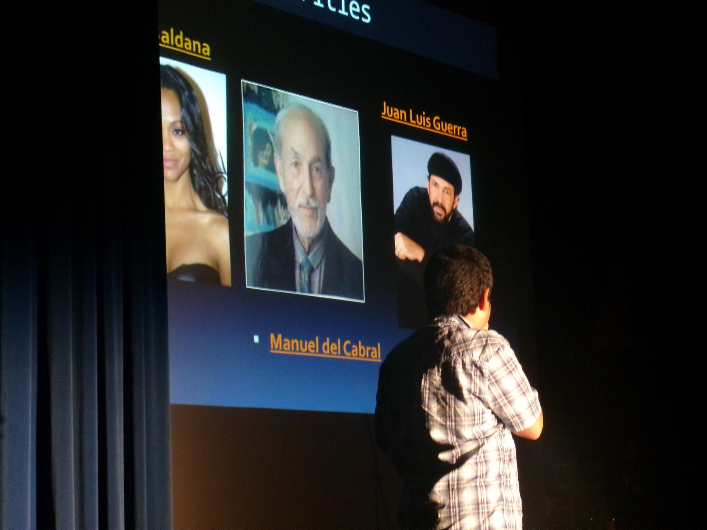

Slide 18
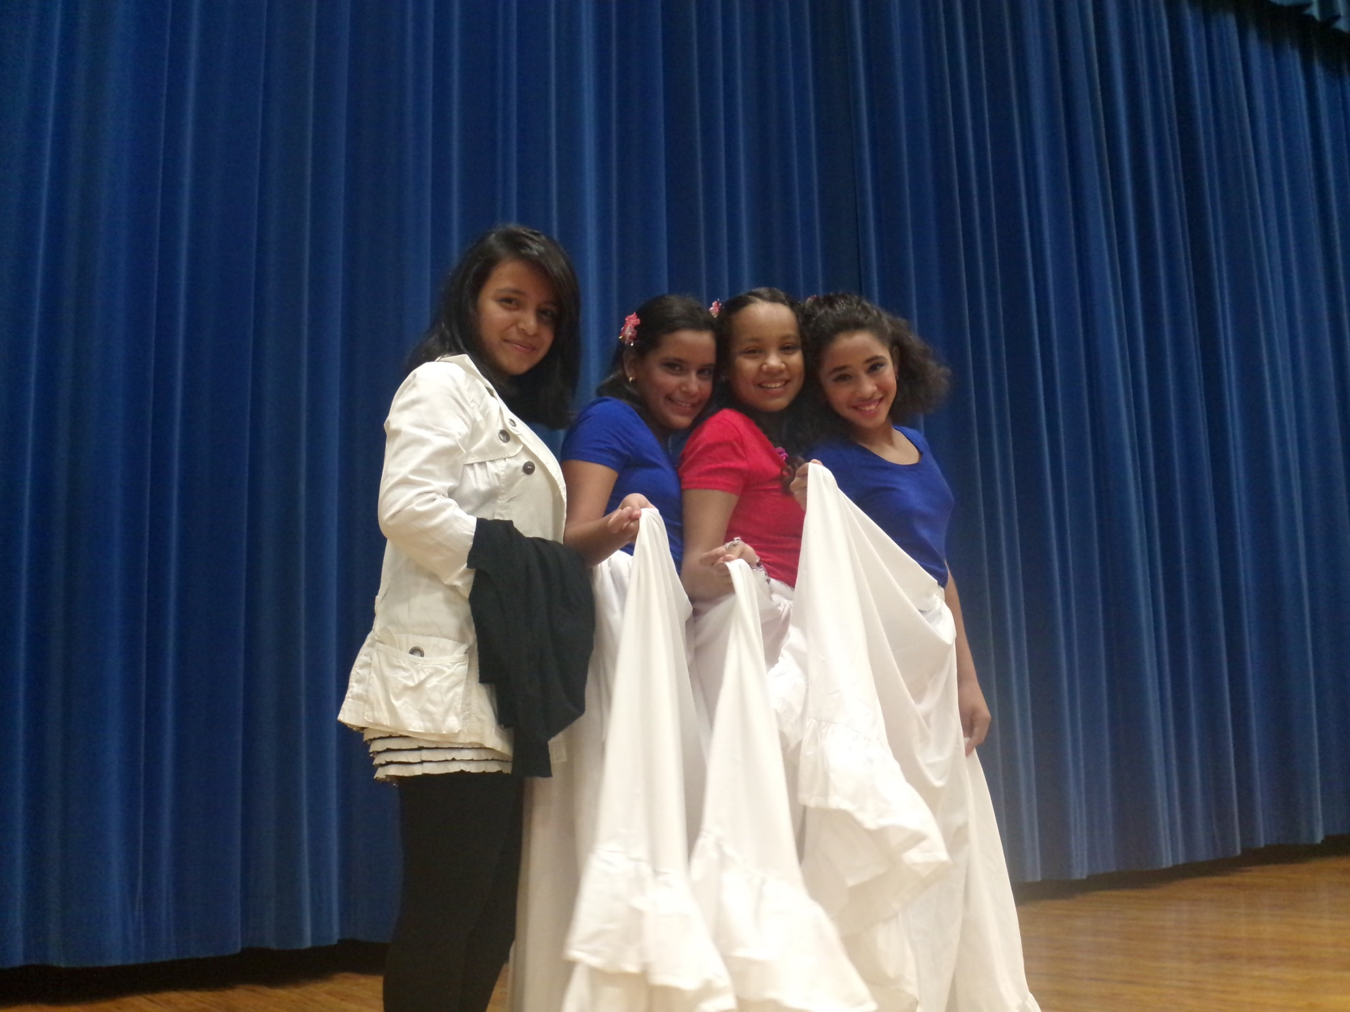

Slide 19

HMS Select Chorus:
Winter Concert Preview

